Slide 1














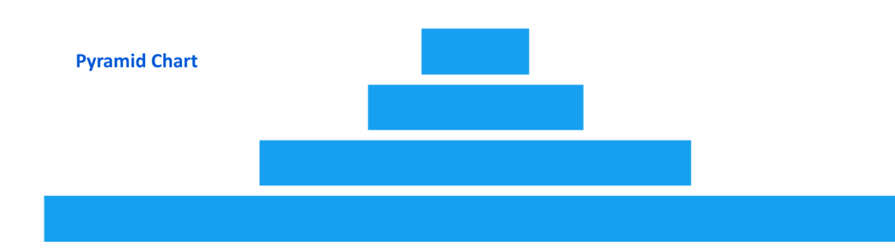

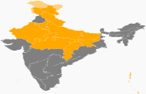





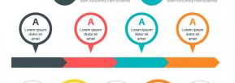
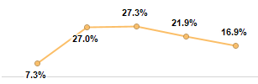
HR People Infographics Dashboard - Jul 2021
HR People Infographics Dashboard - Jul 2021
Total Head Count
All New Hire Onboard
Total Open Positions
Annualized Turnover
58978
2153
500
20.2%
CDCS
4521
CDCS
1634
CDCS
100
CDCS
22%
CDCS
773
CDCS
234
CDCS
150
CDCS
11%
CTTS
535
CTTS
557
CTTS
160
CTTS
10%
CTTS
55
CTTS
77
CTTS
90
CTTS
0.3%
Headcount Pyramid
Headcount Pyramid (%)
1254
658
1912
225
215
440
Addition
Backfill
Total
Addition
Backfill
Total
Location Split
Diversity Mix
Acceptance Ratio
Diversity Mix
Grade Split
Location Split
Diversity Mix
245
333
55
55
55%
45%
Tenure Range (Years)
Source Mix
Location Split
Tenure Range Exits & Attrition %

Slide 2
HR People Infographics Dashboard - Jul 2021
HR People Infographics Dashboard - Jul 2021
Total Head Count
All New Hire Onboard
Total Open Positions
Annualized Turnover
58978
2153
500
20.2%
CDCS
4521
CDCS
1634
CDCS
100
CDCS
22%
CDCS
773
CDCS
234
CDCS
150
CDCS
11%
CTTS
535
CTTS
557
CTTS
160
CTTS
10%
CTTS
55
CTTS
77
CTTS
90
CTTS
0.3%
Headcount Pyramid
Source Mix
Grade Split
Headcount Pyramid (%)
Tenure Range (Years)
Diversity Mix
Acceptance Ratio
Diversity Mix
Diversity Mix
225
215
440
245
333
55
55
Addition
Backfill
Total
55%
45%
Location Split
Location Split
Location Split
1254
658
1912
Addition
Backfill
Total

Slide 3
HR People Infographics Dashboard - Jul 2021
HR People Infographics Dashboard - Jul 2021
Total Head Count
All New Hire Onboard
Total Open Positions
Annualized Turnover
58978
2153
500
20.2%
CDCS
4521
CDCS
1634
CDCS
100
CDCS
22%
CDCS
773
CDCS
234
CDCS
150
CDCS
11%
CTTS
535
CTTS
557
CTTS
160
CTTS
10%
CTTS
55
CTTS
77
CTTS
90
CTTS
0.3%
Headcount Pyramid
Headcount Pyramid (%)
1254
658
1912
225
215
440
Addition
Backfill
Total
Addition
Backfill
Total
Location Split
Diversity Mix
Acceptance Ratio
Diversity Mix
Grade Split
Location Split
Diversity Mix
245
333
55
55
55%
45%
Tenure Range (Years)
Source Mix
Location Split
Tenure Range Exits & Attrition %

Slide 4



HR People Infographics Dashboard - Jul 2021
Total Head Count
All New Hire Onboard
Total Open Positions
Annualized Turnover
58978
2153
500
20.2%
CDCS
4521
CDCS
1634
CDCS
100
CDCS
22%
CDCS
773
CDCS
234
CDCS
150
CDCS
11%
CTTS
535
CTTS
557
CTTS
160
CTTS
10%
CTTS
55
CTTS
77
CTTS
90
CTTS
0.3%
Headcount Pyramid
Headcount Pyramid (%)
1254
658
1912
225
215
440
Addition
Backfill
Total
Addition
Backfill
Total
Location Split
Diversity Mix
Acceptance Ratio
Diversity Mix
Grade Split
Location Split
Diversity Mix
245
333
55
55
55%
45%
Tenure Range (Years)
Source Mix
Location Split
Tenure Range Exits & Attrition %

Slide 5
HR People Infographics Dashboard - Jul 2021
Total Head Count
All New Hire Onboard
Total Open Positions
Annualized Turnover
16456
16456
16456
16456
CDCS
5555
CDCS
5555
CDCS
5555
CDCS
5555
CDCS
5555
CDCS
5555
CDCS
5555
CDCS
5555
CTTS
5555
CTTS
5555
CTTS
5555
CTTS
5555
CTTS
5555
CTTS
5555
CTTS
5555
CTTS
5555
Headcount Pyramid
Headcount Pyramid (%)
1254
658
1912
225
215
440
Addition
Backfill
Total
Addition
Backfill
Total
Location Split
Diversity Mix
Acceptance Ratio
Diversity Mix
Grade Split
Location Split
Diversity Mix
5555
5555
55
55
55%
45%
Source Mix
Location Split
Tenure Range Exits & Attrition %
Tenure Range (Years)
YTD Turnover
20.2%

Slide 6



